Slide 1
Welcome

Slide 2
WHAT IS ROTARY?

Slide 3
WHAT IS ROTARY?
We are neighbors, community leaders, and global citizens uniting for the common good. With you, we can accomplish even more. – Rotary International Web Site
1.2 million members
34,000 clubs in over 200 countries
We are local independent Clubs with a global presence
Our only global goal is to eradicate Polio
Our global community’s impact has never been greater – and it continues to grow. Together, we empower youth, improve health, promote peace, and advance our communities in all corners of the globe.

Slide 4
WHAT IS ROTARY?
We are neighbors, community leaders, and global citizens uniting for the common good. With you, we can accomplish even more. – Rotary International Web Site
1.2 million members
34,000 clubs in over 200 countries
We are local independent Clubs with a global presence
Our only global goal is to eradicate Polio
Our global community’s impact has never been greater – and it continues to grow. Together, we empower youth, improve health, promote peace, and advance our communities in all corners of the globe.

Slide 5
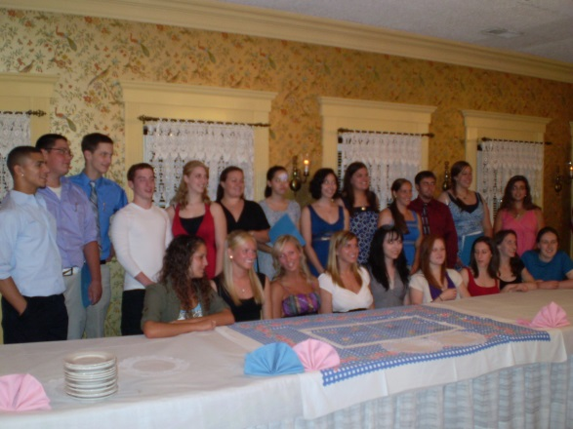
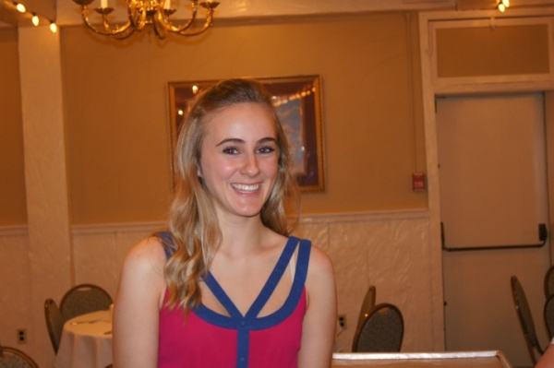
OUR ROTARY CLUB
The Plainville Rotary Club was originally chartered in 1955. Since that time we have been offering service to our community by providing scholarships, community projects and grants. In addition, we have made significant contributions to Rotary’s international efforts.
34 members (representing a variety of vocations)
50% men 50% women
Raise and donate over $40,000 annually
70% scholarships
20% community
10% international
Sponsor Interact Club at the High School
Emma Carpenter
1st President of PHS Interact Club

Slide 6
Plainville Rotary Club MISSION
To provide business, professional and community leaders an opportunity for service to others in order to benefit the community of Plainville and others worldwide.

Slide 7
Plainville Rotary Club VISION
The Rotary Club of Plainville will continue to be the premier Service Club of our community. This can be achieved by:
Supporting the ideals and missions of Rotary International
Improving the quality of life for those we serve
Investing time and or money in at least three community projects and one international project annually which achieve meaningful results in an atmosphere of fun and fellowship
Working together on fundraisers
Increasing membership by at least one new member/year
Having a solid succession plan
Investing in future community leaders by:
Supporting students and young professionals participation in Rotary programs
Awarding a minimum of $25,000 of scholarships annually

Slide 8
Plainville Rotary Club - VISION
Community Based Rotoract – 2014
(18 – 30 years old)
High School Interact 2011
Middle School Interact 2014
Elementary School Early Act (2015 – 2016)
(5 – 13 years old)

Slide 9
OUR PARTNERS
Our club is committed to making a difference in our community. We partner with local organizations to maximize our impact and expand our reach. Including:
Plainville Food Pantry
Wheeler YMCA
Plainville Schools
PARC
Plainville Library
Boy Scouts & Girl Scouts
Plainville Park & Rec Department
Plainville Community Fund
Petit Family Foundation

Slide 10
WHAT IS ROTARY?

Slide 11
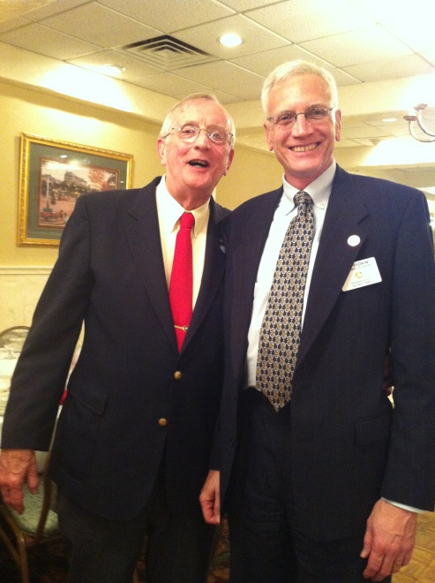
WE ARE ROTARY
Rotary brings together people like you – from all walks of like – who want to use their time and talent to help make good things happen. People whose sense of responsibility inspires them to give back to their communities. At Rotary, we connect to do good – and form lifelong friendships in the process.

Slide 12
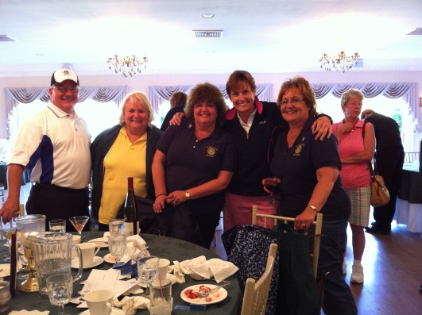
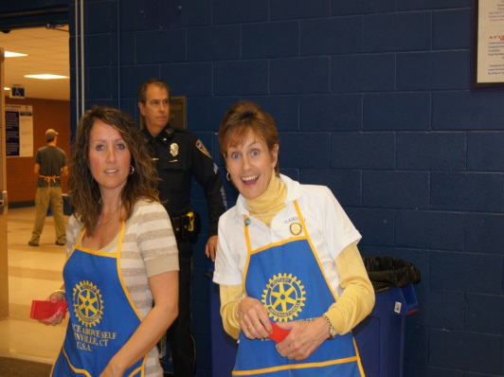
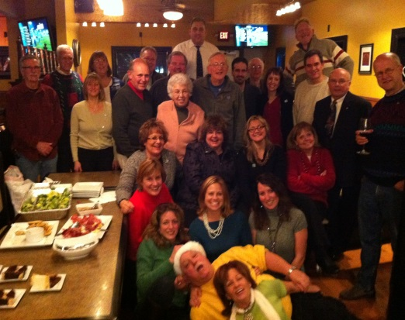
WE ARE ROTARY
Our club gives you an opportunity to join leaders to take action on important issues affecting our community, our nation, and the world. We also have a lot of fun – whether we’re socializing or working together on service project or fundraisers.
Golf Tournament
Penny Sale
Club Holiday Party

Slide 13
WHY DO PEOPLE JOIN ROTARY?
Belonging to a Rotary club provides members with an opportunity to give back to their communities and to connect with like-minded leaders and friends.
People join Rotary for many reasons, including community involvement, personal development, professional networking and camaraderie. But perhaps the most important benefit is the satisfaction you gain from making a real difference in your community and in the world.

Slide 14
WHY DO PEOPLE JOIN PLAINVILLE ROTARY

Slide 15
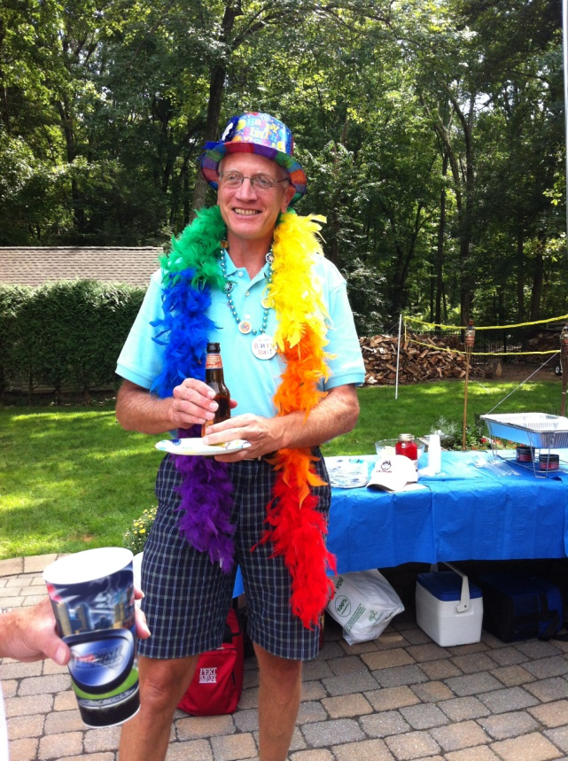
WHY DO PEOPLE JOIN PLAINVILLE ROTARY
We have fun! And …

Slide 16
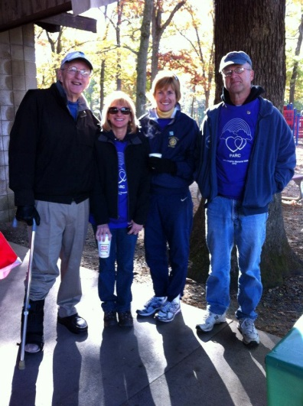
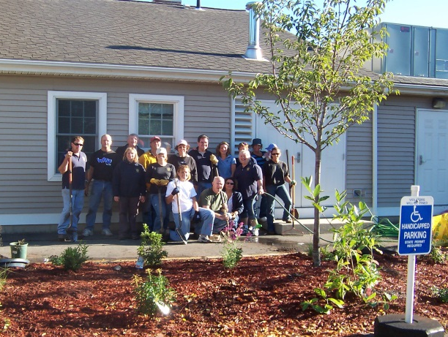
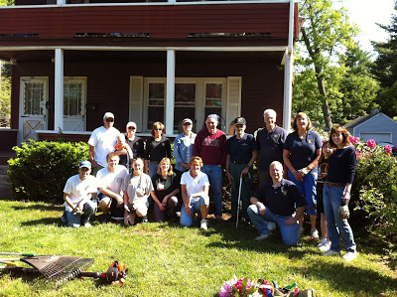
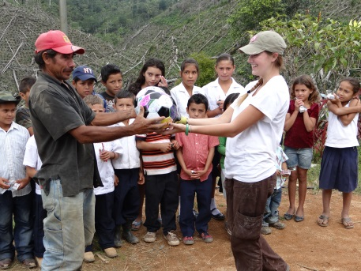
WE MAKE A DIFFERENCE
Ringing the Bell for the Salvation Army
Helping beautify the Plainville Senior Center
Supporting the PARC Walk
Day of Service for local Veteran
Honduras Water Project

Slide 17
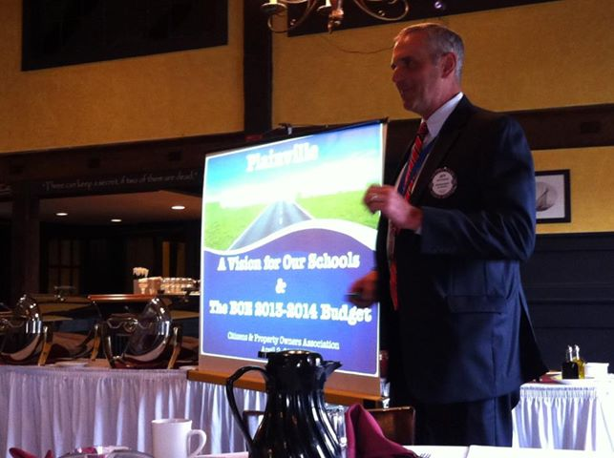
OUR ROTARY CLUB
Members of our Rotary club connect at weekly meetings and learn from business experts, political and civic leaders, who help us stay informed on topics that are relevant to our community and to our work as Rotarians.
Together, we make great things happen. We have a structure that focuses on action and positive results.
Presentation by Dr. Jeff Kitching, Superintendent of
Plainville Public Schools
Notes:
Talk about weekly meeting format.

Slide 18
CLUB FUNDRAISERS
Providing the funding for all of our programs requires dedicated individuals working together for the benefit of the community. Our club has approximately 34 members that run three primary fundraisers.
Citrus Sale
Oranges and grapefruit are sold through October and November for delivery in time for the holidays. The fruit is delivered fresh from Florida.
Penny Sale
Each spring, $1 tickets have a chance to win 100 prizes. In total over 300 prizes are awarded at this family event.
Golf Tournament
The annual Sandy Parson Memorial Golf Tournament is held in June. There is a putting contest, hole in one contest, and raffles along with dinner. We are always looking for golfers and sponsors.

Slide 19
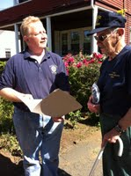
RECENT PROJECTS
Scholarships: over the past 4 years, we have contributed over $100,000 in scholarships to Plainville students
Community Projects:
Drug Box in the Police Station
New band shell at Norton Park
Holiday party for elementary school students
Plainville Senior Center landscaping
Day of Service for a Veteran

Slide 20
MEMBERSHIP RESPONSIBILITIES
What Rotarians get out of Rotary depends largely on what they put into it. Membership requirements are designed to help club members more fully participate in and enjoy their Rotary experience.
Financial: $125 annually; $11 for weekly lunch; fellowship fund contributions at weekly meetings
Service: by participating in local and international service projects, club members can volunteer their time and talents where they’re most needed. It takes participation from all club members to make our club successful!
Attendance: 50% attendance expectation

Slide 21
GET TO KNOW US
The Plainville Rotary Club
meets every Monday at 12:15-1:15pm
at J. Timothy’s Restaurant
For more information about our club, projects and our upcoming events, visit www.plainvillectrotary.org

